Slide 1

MUZAN
Flutterwave Hackathon
Spanish 101
Bringing the Fourth Industrial Revolution to Homes

Slide 2

INTRODUCTION
We’ve Understood the Need for data in making user centered decisions through in-depth analysis

Slide 3
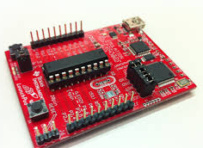
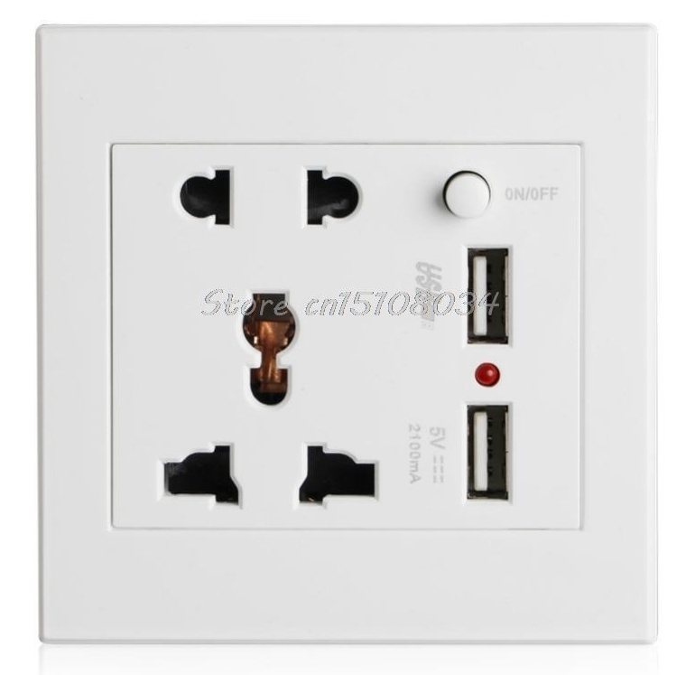
Digital Signal Processor +
Wall SocketPi
+
Open source Hardware
Mostly use by Electronic Hobbyists.
This Projects aims to usher in the Fourth Industrial Revolution to the Community

Slide 4
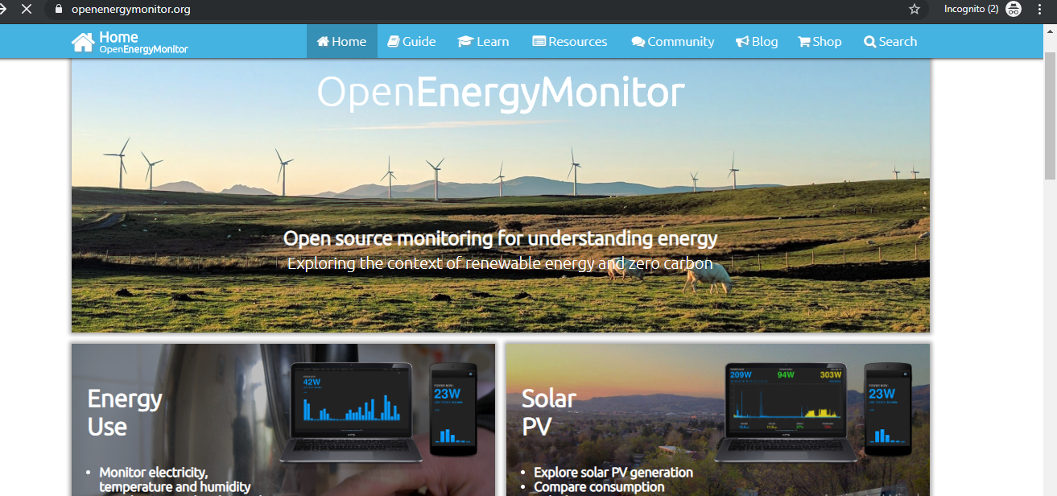

Slide 5
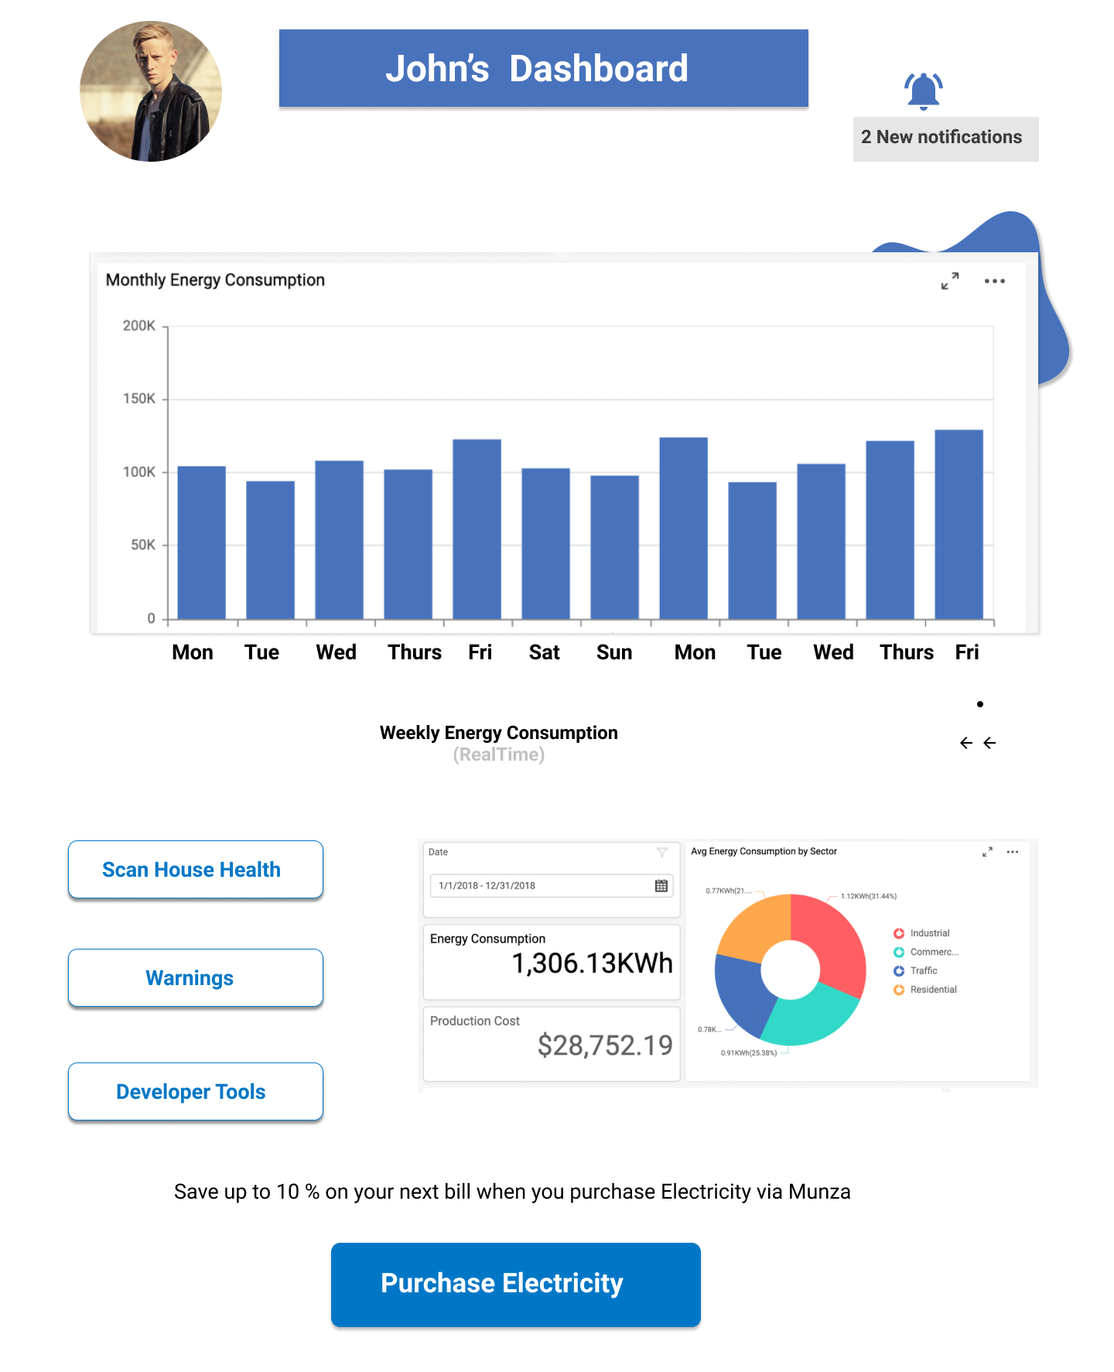
Users have a Dashboard, which Oversees their Energy Consumption Activity in their Houses

Slide 6
The Dashboard helps in
visualizing Real Time
Energy Consumption Data
and offers discounts on
Electricity Payments via
Gamification on Energy Savings

Slide 7
Provide Rewards/ Incentives,
Through Gamification
which enables Users return to
Perform
Electricity Payment

Slide 8
Bicycle

Slide 9
Bicicleta
Bicycle

